Slide 1
NLP
Research considerations on training data and model structure

Slide 2
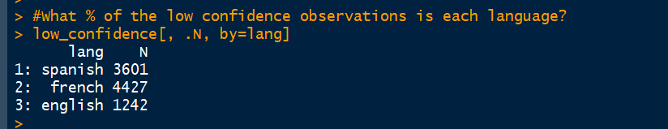
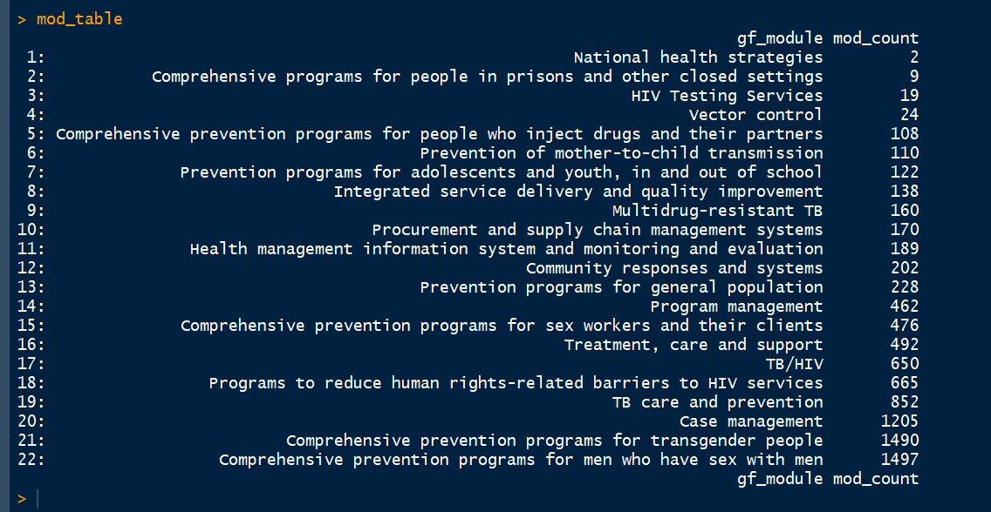
Current project status

Slide 3
Current status of training data

Slide 4
Training Data
Should we even use 2015-2017 as training data? Because they had so much trouble with classification even into the modular framework at that point?
Concern - the hand-coded NLP training data was run through Irena’s old map. So the module/intervention you’re seeing there is NOT the module/intervention that was in the original file, and there are all of the errors of classification we already know about.
Concern - it’s not clear that these data were picked from 2018-2020 grant period, or what period they did come from. We know the country teams’ classification has already improved greatly between 2015-2017 and 2018-2020, so it makes sense to only pull training data from the later period.

Slide 5
Training Data
Concern - not all codes are represented in the training data, and the data is very highly skewed towards malaria case management and vector control. There is not an even distribution between languages, or diseases.
RSSH is not being treated as its own disease in the model, and neither is HIV/TB.
All of the iteration data has unreadable characters in the activity description column that can’t be pulled in either as unicode or latin-1. It looks like the encoding got lost somewhere along the way when writing to file.
We’re not pulling in any English acronyms

Slide 6
Training Data
How big is a representative sample? How can you stratify this? By disease?
Ideally, we would not rely as much on observation frequency, because we want the model to base its decisions mostly on the context of the text, but we may want to also add a ‘frequency weight’ to the data balancing.
Beginning by sampling by disease? Ignoring language or not?

Slide 7
Model structure
RSSH is not being treated as its own disease in the model, and neither is HIV/TB.
We’re not pulling in any English acronyms, and there didn’t seem to be a systematic review to make sure the dictionary keys in Spanish and French were all getting caught by their respective acronym lists. There were a lot of unnecessary acronyms.
Are we using continuous models (regression) to try to predict discrete variables? Review Wilson’s code.

